Slide 1


May Connect Metrics
Clarence Lau

Slide 2
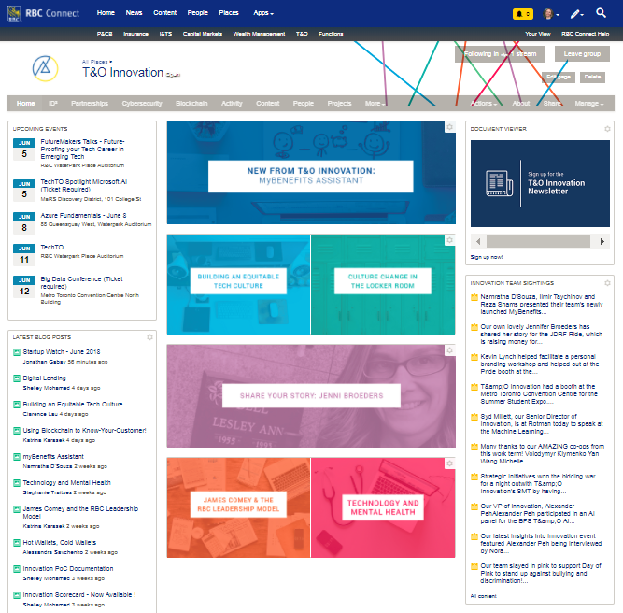
Innovation Homepage
April 3rd, 2018:
894 Followers
June 5th, 2018
958 Followers
7.15% Increase

Slide 3
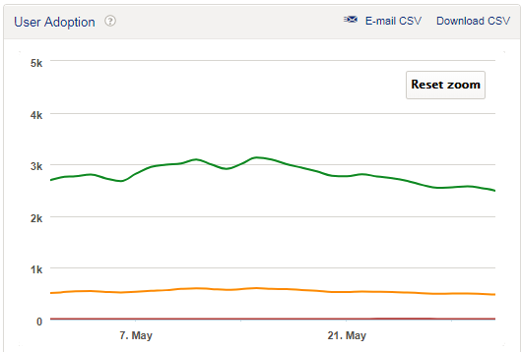
User Adoption: May
Stats
2476 Active Users
482 Participating Users
11 Contributing Users
Rates
Engagement Rate: 19.46%
Contribution Rate: 0.44%
Notes:
Graph will be changed for end of month (May 31)

Slide 4
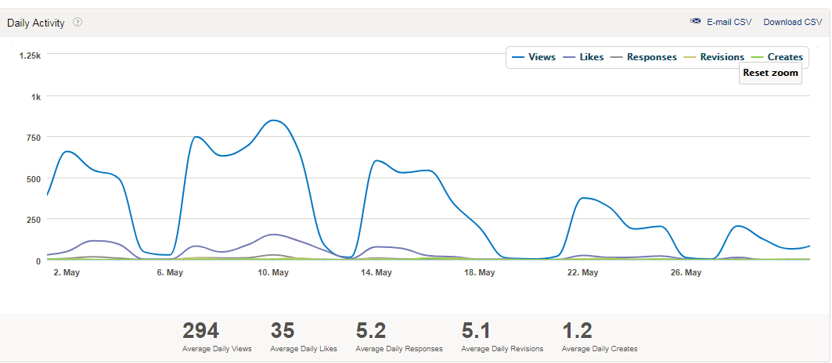
Daily Activity: May
Stats
9656 Views
1144 Likes
156 Responses
26 Creates
Rates
Engagement Rate: 13.75%
Notes:
Graph will be changed for end of month (May 31)

Slide 5



Successes
Older posts still attracting engagement
New employees are becoming users
Diverse topics and styles of content

Slide 6



Areas of Improvement
Less content created overall
Less featured posts on the homepage
.
Decreased user adoption

Slide 7
The Most Popular Innovation Employee on Connect in May was…

Slide 8


…Devon!

Slide 9
Top May Posts on Connect (We’ve always got more work to do)
1. Take 10 Breaths | Lisa Helm | 1,464 views
2. Should you "risk" your career on a startup or an established company? | Lisa Helm | 1,410 views
3. The State of Cryptocurrency | Clarence Lau | 1,082 views
4. Are cryptocurrency and blockchain the same thing? | Devon Lacombe | 781 views
5. Will Cryptocurrencies Replace Fiat Currencies? | Lisa Helm | 701 views
Notes:
table

Slide 10
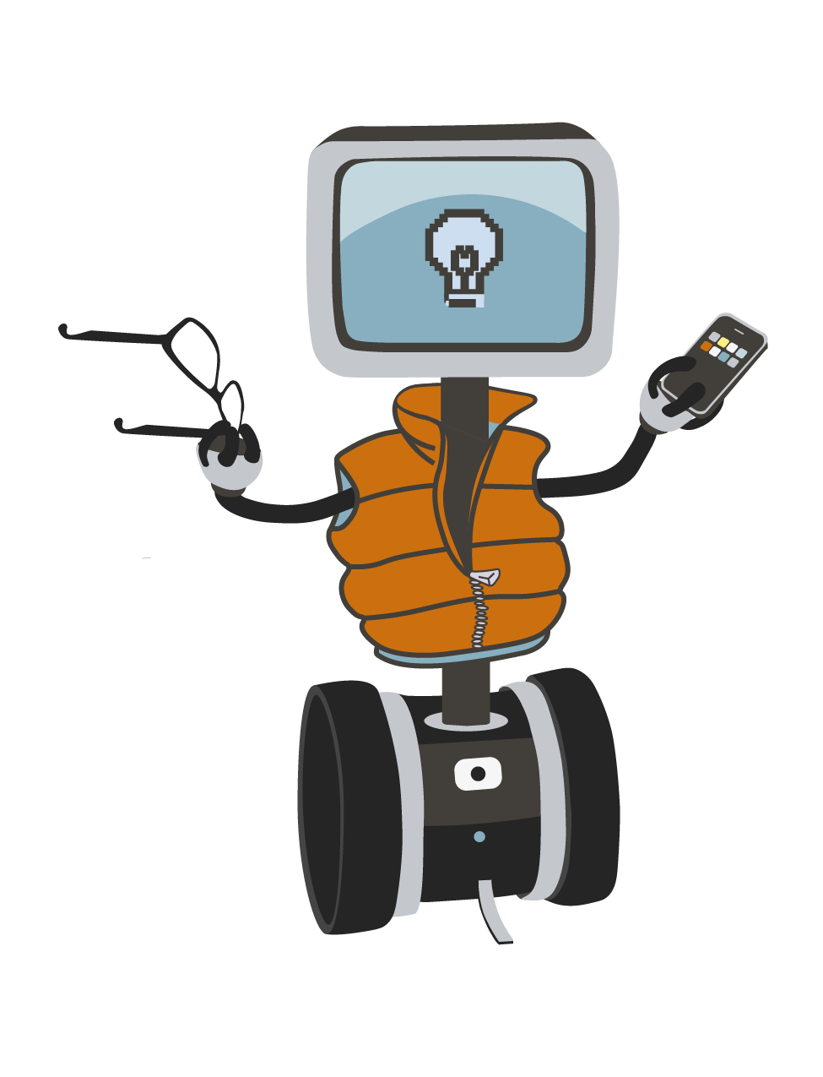
Questions?
If you’d like to contribute, talk to Lisa or Clarence
Thanks for Listening!
Notes:
If people want to contribute – TALK TO MYSELF OR LISA, we can put it into the content calendar

